Slide 1
Peer-to-Peer Networks
07 Degree Optimal Networks
Christian Schindelhauer
Technical Faculty
Computer-Networks and Telematics
University of Freiburg

Slide 2
Diameter and Degree in Graphs
CHORD:
degree O(log n)
diameter O(log n)
Is it possible to reach a smaller diameter with degree g=O(log n)?
In the neighborhood of a node are at most g nodes
In the 2-neighborhood of node are at most g² nodes
...
In the d-neighborhood of node are at most g^{d} nodes
So,
Therefore
So, Chord is quite close to the optimum diameter.

Slide 3
Are there P2P-Netzwerke with constant out-degree and diameter log n?
CAN
degree: 4
diameter: n^{1/2}
Can we reach diameter O(log n) with constant degree?

Slide 4
Degree Optimal Networks
Distance Halving
Moni Naor, Udi Wieder
2003

Slide 5
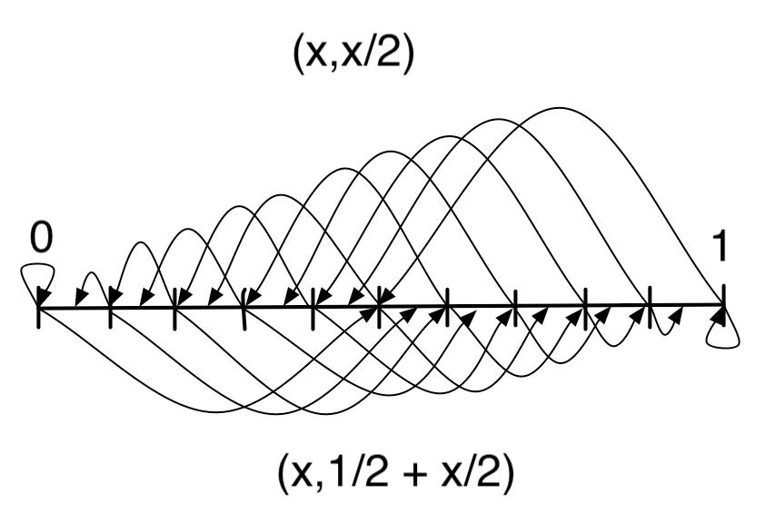
Continuous Graphs
are infinite graphs with continuous node sets and edge sets
The underlying graph
x ∈ [0,1)
Edges:
(x,x/2), left edges
(x,1+x/2), right edges
plus revers edges.
(x/2,x)
(1+x/2,x)

Slide 6
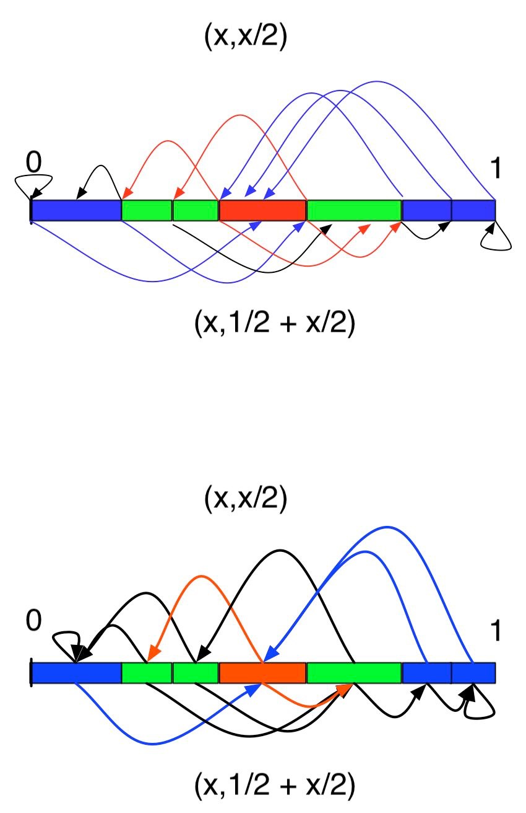
The Transition from Continuous to Discrete Graphs
Consider discrete intervals resulting from a partition of the continuous space
Insert edge between interval A and B
if there exists x ∈ A and y ∈ B such that edge (x,y) exists in the continuous graph
Intervals result from successive partitioning (halving) of existing intervals
Therefore the degree is constant if
the ratio between the size of the largest and smallest interval is constant
This can be guarranteed by the principle of multiple choice
which we present later on

Slide 7
Principle of Multiple Choice
Before inserted check c log n positions
For position p(j) check the distance a(j) between potential left and right neighbor
Insert element at position p(j) in the middle between left and right neighbor, where a(j) was the maximum choice
Lemma
After inserting n elements with high probability only intervals of size 1/(2n), 1/n und 2/n occur.

Slide 8
Proof of Lemma
1st Part: With high probability there is no interval of size larger than 2/n
follows from this Lemma
Lemma*
Let c/n be the largest interval. After inserting 2n/c peers all intervals are smaller than c/(2n) with high probability
From applying this lemma for c=n/2,n/4, ...,4 the first lemma follows.

Slide 9
Proof
2nd part: No intervals smaller than 1/(2n) occur
The overall length of intervals of size 1/(2n) before inserting is at most 1/2
Such an area is hit with probability at most 1/2
The probability to hit this area more than c log n times is at least
Then for c>1 such an interval will not further be divided with probability into an interval of size 1/(4m).

Slide 10
Chernoff-Bound
Theorem Chernoff Bound
Let x1,...,xn independent Bernoulli experiments with
P[xi = 1] = p
P[xi = 0] = 1-p
Let
Then for all c>0
For 0≤c≤1

Slide 11
Proof of Lemma*
Consider the longest interval of size c/n. Then after inserting 2n/c peers all intervals are smaller than c/(2n) with high probability.
Consider an interval of length c/n
With probability c/n such an interval will be hit
Assume, each peer considers t log n intervals
The expected number of hits is therefore
From the Chernoff bound it follows
If then this interval will be hit at least times
Choose
Then, every interval is partitioned w.h.p.

Slide 12
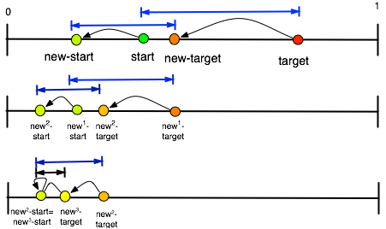
Lookup in Distance-Halving
Map start/target to new-start/target by using left edges
Follow all left edges for 2+ log n steps
Then, the new-new...-new-start and the new-new-...new-target are neighbored.

Slide 13
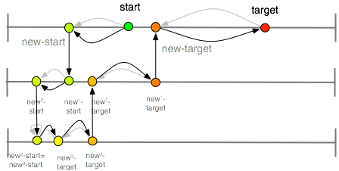
Lookup in Distance-Halving
Follow all left edges for 2+ log n steps
Use neighbor edge to go from new*-start to new*-target
Then follow the reverse left edges from new^{m+1}-target to new^{m}-target

Slide 14
Structure of Distance-Halving
Peers are mapped to the intervals
uses DHT for data
Additional neighbored intervals are connected by pointers
The largest interval has size 2/n w.h.p.
i.e. probability 1-n^{-c} for some constant c
The smallest interval size 1/(2n) w.h.p.
Then the indegree and outdegree is constant
Diameter is O(log n)
which follows from the routing

Slide 15
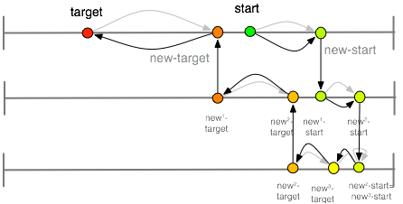
Lookup in Distance-Halving
This works also using only right edges

Slide 16
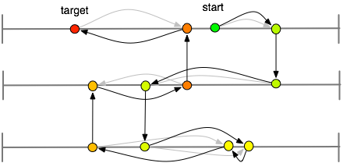
Lookup in Distance-Halving
This works also using a mixture of right and left edges

Slide 17
Congestion Avoidance during Lookup
Left and right-edges can be used in any ordering
if one stores the combination for the reverse edges
Analog to Valiant‘s routing result for the hyper-cube one can show
The congestion ist at most O(log n),
i.e. every peer transports at most a factor of O(log n) more packets than any optimal network would need
The same result holds for the Viceroy network

Slide 18
Inserting peers in Distance-Halving
Perform multiple choice principle
i.e. c log n queries for random intervals
Choose largest interval
halve this interval
Update ring edges
Update left and right edges
by using left and right edges of the neighbors
Lemma
Inserting peers in Distance Halving needs at most O(log² n) time and messages.

Slide 19
Summary Distance-Halving
Simple and efficient peer-to-peer network
degree O(1)
diameter O(log n)
load balancing
traffic balancing
lookup complexity O(log n)
insert O(log²n)
We already have seen continuous graphs in other approaches
Chord
CAN
Koorde
ViceRoy

Slide 20
Degree Optimal Networks
Koorde M. Frans Kaashoek and David R. Karger 2003

Slide 21
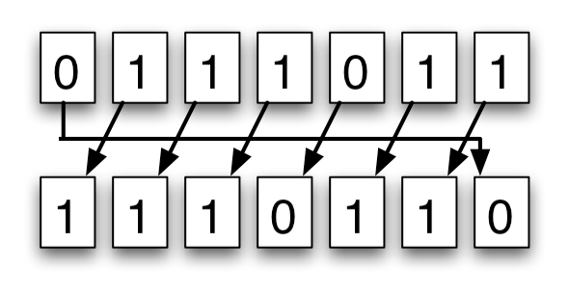
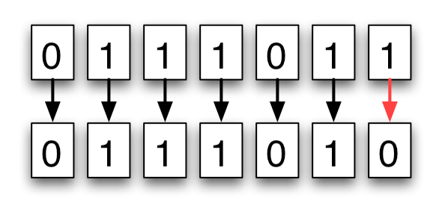
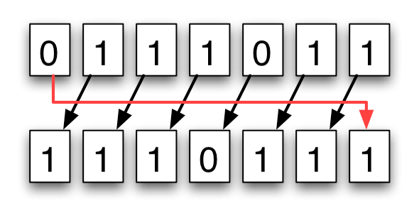
Shuffle, Exchange, Shuffle-Exchange
Shuffle
Consider binary string s of length m
shuffle operation:
shuffle(s₁, s₂, s₃,..., s_{m}) = (s₂,s₃,..., s_{m},s₁)
exchange:
exchange(s₁, s₂, s₃,..., s_{m}) = (s₁, s₂, s₃,..., ¬s_{m})
shuffle exchange:
SE(S) = exchange(shuffle(S)) = (s₂,s₃,..., s_{m}, ¬ s₁ )
Observation:
Every string a can be transformed into a string b by at most m shuffle and shuffle exchange operations
Exchange
Shuffle-Exchange

Slide 22
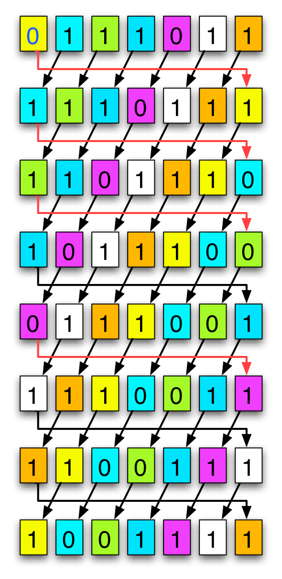
Magic Trick
SE
Observation
Every string a can be transformed into a string b by at most m shuffle and shuffle exchange operations Beispiel:
From 0 1 1 1 0 1 1
to 1 0 0 1 1 1 1
via SE SE SE S SE S S
operations
SE
SE
S
SE
S
S

Slide 23
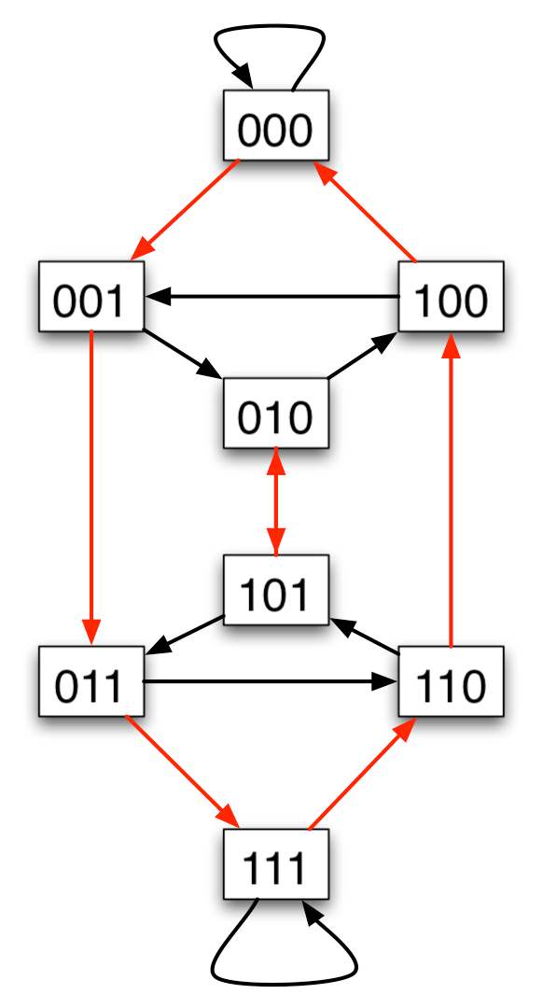
The De Bruijn Graph
A De Bruijn graph consists of n=2m nodes,
each representing an m digit binary strings
Every node has two outgoing edges
(u,shuffle(u))
(u, SE(u))
Lemma
The De Bruijn graph has degree 2 and diameter log n
Koorde = Ring + DeBruijn-Graph

Slide 24
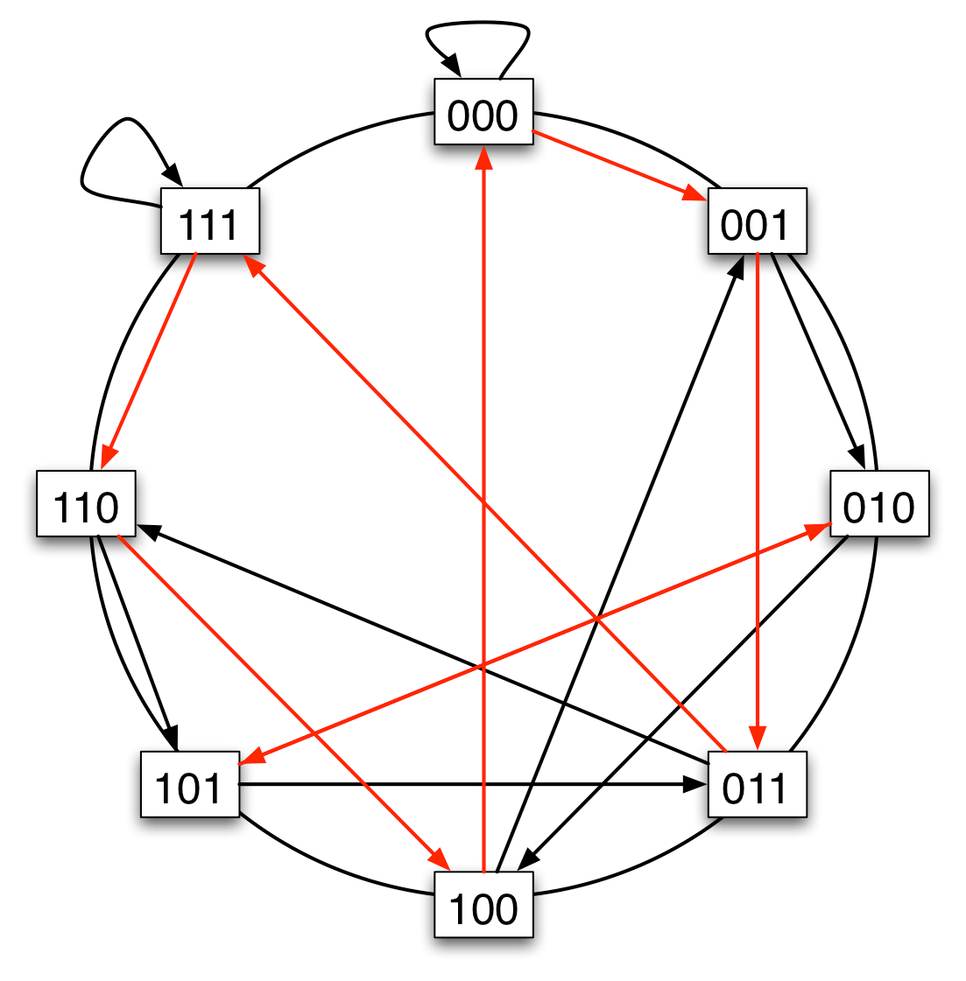
Koorde = Ring + DeBruijn-Graph
Consider ring with 2^{m} nodes and De Bruijn edges

Slide 25
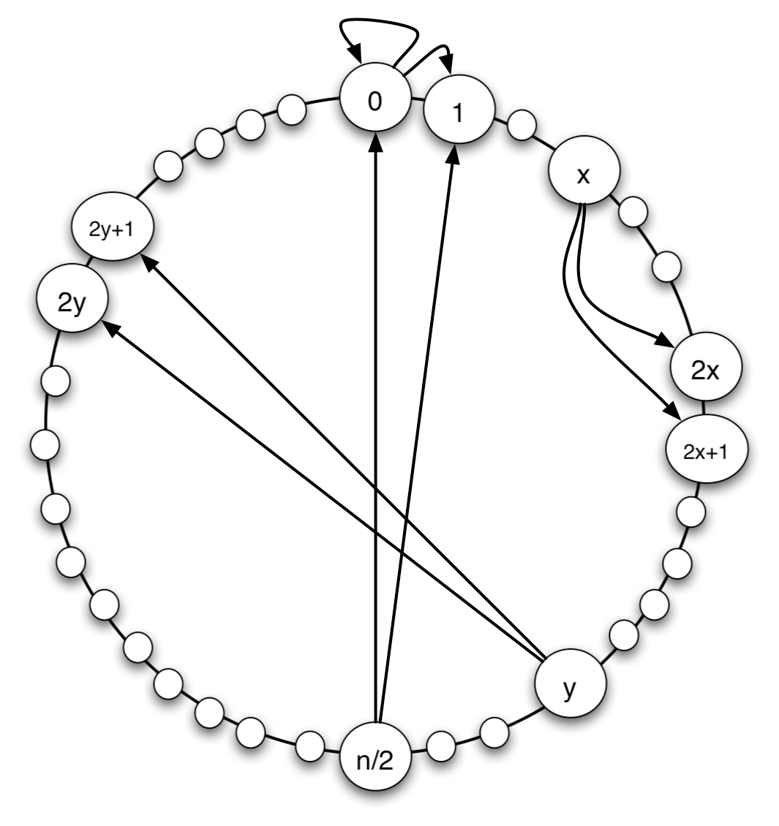
Koorde = Ring + DeBruijn-Graph
Note
shuffle(s1, s2,..., sm) = (s2,..., sm,s1)
shuffle (x) = (x div 2^{m-1})+(2x) mod 2^{m}
SE(S) = (s2,s3,..., sm, ¬ s1 )
SE(x) = 1-(x div 2^{m-1})+(2x) mod 2^{m}
Hence: Then neighbors of x are
2x mod 2^{m} and
2x+1 mod 2^{m}

Slide 26
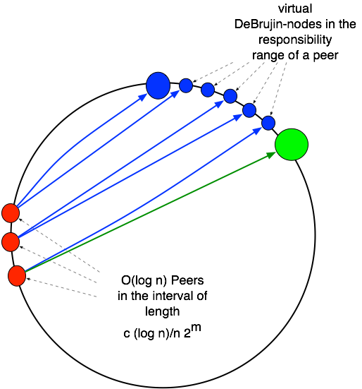
Virtual DeBruijn Nodes
To avoid collisions we choose
m > (2+c) log (n)
Then the probability of two peers colliding is at most n^{-c}
But then we have much mor nodes in the graph than peers in the network
Solution
Every peer manages all DeBruijn nodes between his position and his successor on the ring
only for incoming edges
outgoing edges are considered only from the peer‘s poisition on the ring

Slide 27
Properties of Koorde
Theorem
Every node has four pointers
Every node has at most O(log n) incoming pointers w.h.p.
The diameter is O(log n) w.h.p.
Lookup can be performed in time O(log n) w.h.p.
But:
Connectivity of the network is very low.

Slide 28
Properties of Koorde
Theorem
1. Every node has four pointers
2. Every node has at most O(log n) incoming pointers w.h.p.
Proof:
1. follows from the definition of the DeBruijn graph and the observation that only non-virtual nodes have outgoing edges
2. The distance between two peers is at most c (log n)/n 2^{m} with high probability
The number of nodes pointing to this distance is therefore at most c (log n) with high probability

Slide 29
Properties of Koorde
Theorem
The diameter is O(log n) w.h.p.
Lookup can be performed in time O(log n) w.h.p.
Proof sketch:
The minimal distance of two peers is at least n^{-c} 2^{m} w.h.p.
Therefore use only the c log n most significant bits in the routing
since the prefix guarantees that one end in the responsibility area of a peer
Follow the routing algorithm on the De-Bruijn-graph until one ends in the responsibility area of a peer

Slide 30
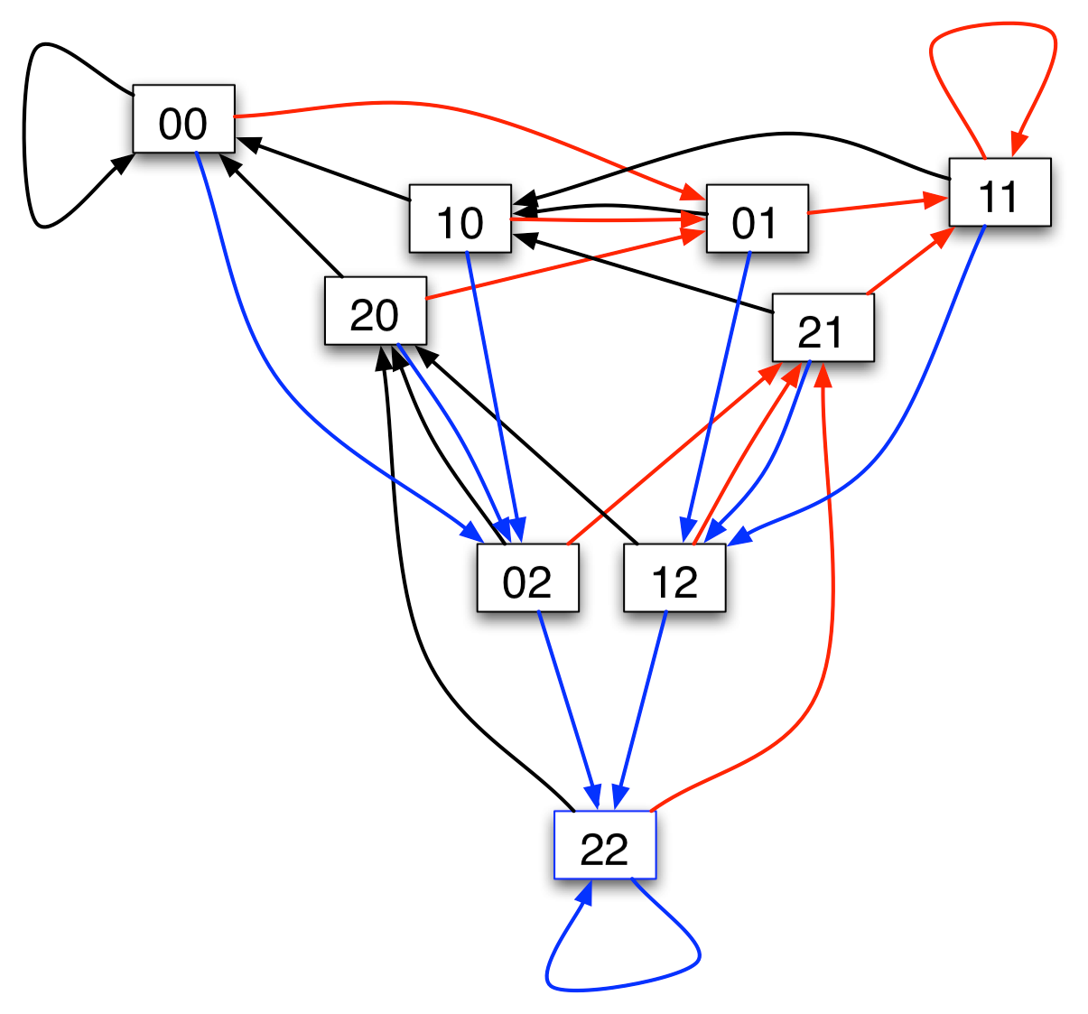
Degree k-DeBruijn-Graph
Consider alphabet using k letters, e.g. k = 3
Now, every k-DeBruijn-node has successors
(kx mod km)
(kx +1 mod km)
(kx+2 mod km)
... (kx+k-1 mod km)
Diameter is reduced to
(log m)/(log k)
Graph connectivity is increased to k

Slide 31
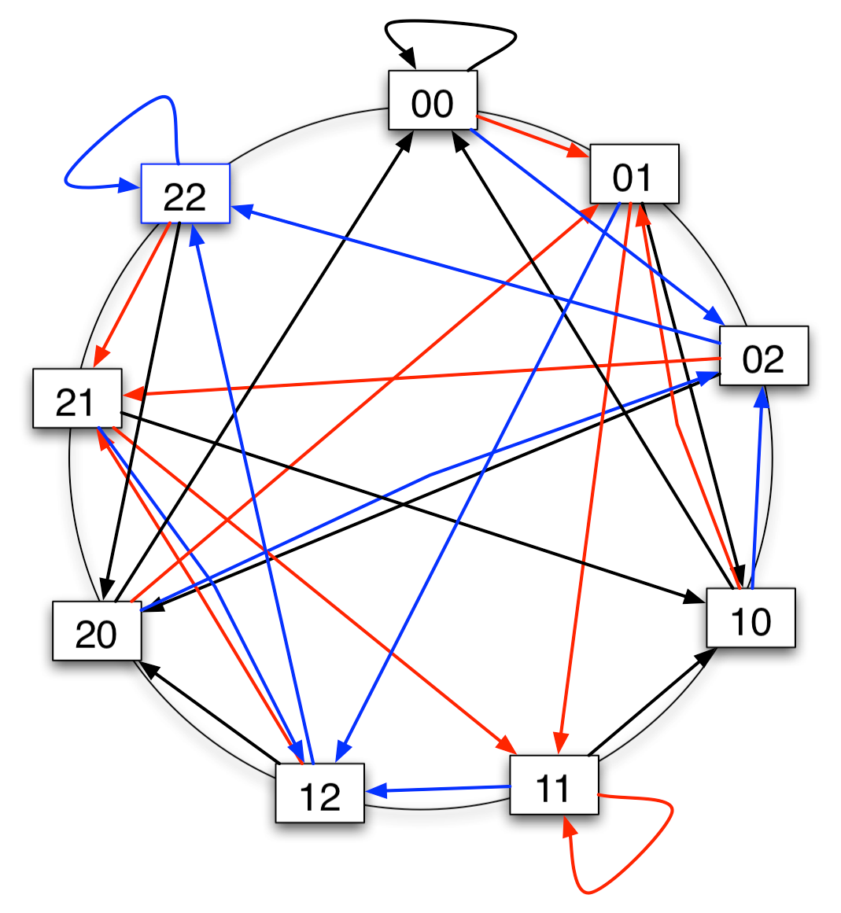
k-Koorde
Straight-forward generalization of Koorde
by using k-DeBruijn graphs
Improves lookup time and messages to O((log n)/(log k)) steps

Slide 32
Peer-to-Peer Networks
07 Degree Optimal Networks
Christian Schindelhauer
Technical Faculty
Computer-Networks and Telematics
University of Freiburg

